Slide 1

AN INTRODUCTION TO
SCORE
SMALL CITIES
ORGANIZED RISK EFFORT
JOINT POWERS AUTHORITY
October 26, 2017

Slide 2
Mission Statement
The Small Cities Organized Risk Effort or SCORE, is an association of municipalities joined to protect member resources by stabilizing risk costs in a reliable, economical and beneficial manner while providing members with broad coverage and quality services in risk management and claims management.

Slide 3
What is SCORE?
SCORE is a Joint Powers Authority (JPA) created under the authority of Government Code* by agreement of the member public entities, after the governing boards of the entities determined that it is in their own best interest and the public interest that SCORE be formed.
* Sections 990, 990.4, 990.8 and 6500-6515

Slide 4
Why was SCORE formed?
To be free of Insurance Industry Cycles
  Reduce costs overall
  Stop riding the rollercoaster
Help each other with risk management issues
Provide broader coverage and services for less than members could obtain on their own.

Slide 5
SCORE History
  JPA and Liability Program formed in 1986
  with 13 members
Members:
Biggs | Live Oak | Susanville
Colfax | Loomis | Williams
Dunsmuir | Loyalton | Yreka
Etna | Montague
Isleton | Portola

Slide 6
SCORE Growth
History - Cities Added
  1987 - Cities of Dorris and Weed
  1988 - City of Mt. Shasta
  1991 - City of Ione
  1992 - City of Crescent City
  1993 - Cities of Ft. Jones and Shasta Lake
  2002 - City of Rio Dell
  2011 - City of Tulelake

Slide 7
Workers’ Compensation
Program formed in 1993 with 10 members
Members |  | Mini Cities:
Crescent City | Susanville | Colfax
Dunsmuir | Weed | Ft. Jones
Ione | Williams | Loomis
Mount Shasta | Yreka | Portola
Shasta Lake

Slide 8
SCORE Meeting Dates 2018
Date | Time | Location
January 19, 2018 | 10:00 am | Gaia Hotel, Anderson, CA
March 30, 2018 | 10:00 am | Gaia Hotel, Anderson, CA
June 15, 2018 | 10:00 am | Gaia Hotel, Anderson, CA

Slide 9
Membership
The small size of member Cities limits their ability to have a risk manager on their staff.
Generally, the City Manager or Finance Officer is involved in risk management.
Group purchase of contract services provides an efficient way to obtain risk management expertise within cities’ budgets.
Board attendance approaches 100%.

Slide 10
Membership
City | Pop. | Projected Payroll FYE 2017 | Safety
Biggs | 1,707 | $391,965 | Police
Colfax | 1,983 | $458,398 | Vol. Fire
Dunsmuir | 1,650 | $501,535 | Vol. Fire
Etna | 737 | $382,228 | Police & Vol. Fire
Fort Jones | 839 | $316,012 | Vol. Fire
Isleton | 804 | $216,217 | Vol. Fire
Live Oak | 8,500 | $1,319,431 | None
Loomis | 6,430 | $760,704 | None
Loyalton | 729 | $140,726 | Vol. Fire

Slide 11
Membership
City | Pop. | Projected Payroll FYE 2017 | Safety
Montague | 1,443 | $335,336 | Vol. Fire
Mt. Shasta | 3,394 | $1,817,047 | Police & Fire
Portola | 2,104 | $742,971 | Vol. Fire
Rio Dell | 3,369 | $1,007,403 | Police Only
Shasta Lake | 10,213 | $3,534,954 | None
Susanville | 16,616 | $3,784,518 | Police & Fire
Tulelake | 993 | $359,828 | Police & Vol .Fire
Weed | 2,941 | $1,588,057 | Police & Vol. Fire
Yreka | 7,679 | $2,912,181 | Police & Vol. Fire
TOTAL |  | $20,569,511

Slide 12
SCORE Overview
The Governance
The Program Services
Claims Administration
The Programs
Funding Mechanisms

Slide 13

SCORE
The Governance

Slide 14
Board of Directors
All members are represented on the Board by their City-Appointed Representative and Alternate.
Each Rep, or in their absence the Alternate, has a single vote.
Minimum of four regular meetings a year:
  4TH Friday of January, March, June, August and October
  Meeting length is approximately 3 hours
  Meeting dates are established by Board resolution adopted at the last regular Board meeting of every fiscal year.

Slide 15
The Officers
  President – Roger Carroll – Town of Loomis
  Vice President – Steve Baker, City of Yreka
  Treasurer – Linda Romaine – Town of Fort Jones
  Secretary – Brooke Woodcox– City of Rio Dell
  EC Member at Large – John Duckett, City of Shasta Lake
  Terms are 2 years, terminating on the even years

Slide 16
The Executive Committee
The Executive Committee consists of the five Officers
    President
    Vice President
    Treasurer
    Secretary
    Member At Large
The Committee is assigned authority to conduct business when needed on items not requiring a special Board meeting.

Slide 17
Governing Documents
Joint Powers Agreement
JPA Bylaws
Master Plan Documents
  Liability
  Workers’ Compensation
Policies and Procedures

Slide 18
Governing Documents
  Joint Powers Agreement
    Any Public Entity
    Anywhere in California
    Government Codes
      Funds belong to JPA
      Returns and assessments continue past termination
    2/3rds of the Member governing bodies to change

Slide 19
Governing Documents
  Bylaws
    Provide more detail than JPA Agreement
    Establishes powers of the Board and Executive Committee
    2/3rds of the Board to change
  Master Plan Documents
    Governs the procedures, rights and obligations of a program
    Defines process for deposits and retrospective adjustments
    One for each self-insured program
    2/3rds of the Board to change or amend

Slide 20
Governing Documents
  Memorandum of Coverage (MOC)
    Defines the claims covered
    Follow the excess coverage for the most part
      Does NOT include Employment Practices Liability (EPL)
      Covers SOME types of inverse claims
    Defines rights, duties and processes to follow in the event of a claim

Slide 21
Governing Documents
Policy and Procedures
  Administrative
  Liability
  Workers’ Compensation
  Risk Management

Slide 22

SCORE
The Program Services

Slide 23
JPA Administration
Program Administration Team:
Marcus Beverly Marcus.Beverly@alliant.com
Michelle Minnick Michelle.Minnick@alliant.com

Slide 24
JPA Administration
  Prepare Agendas and Coordinate Meetings
  Develop and Maintain Policy and Procedures
  Preparation of Annual Budget and Program Deposits
  Issue, Modify and Maintain Memorandums of Coverage for the Shared Risk layer
  Maintain SCORE Documents
  Risk Management Services
    Resource For Risk Management Questions and Information
    Coordinate Development of Loss Control Material
    Contract Review for Insurance Requirements

Slide 25
Risk Control Services
  DKF Solutions
  On Site Assessments, Assistance, and Training
  OSHA Policy Development and Training
  Sewer Operation Risk Management
  Phone and E-mail Hotline for Questions
  My Safety Officer Online Training

Slide 26
Other Training Provided
Target Solutions – Web based training and resources
  www.targetsolutions.com/SCORE
Lexipol – Police procedures & training bulletins
Conference Participation is encouraged
  PARMA
  CAJPA

Slide 27

SCORE
Claims Administration

Slide 28
Claims Administration by York
  Claims Management Information System (CMIS)
    Online, Real-Time Client Access to Claims Information
    Clients May Run Reports, Loss Reports, and Claim Logs
  Designated Client Relations Director – Dori Zumwalt
    Production of Monthly Loss Runs
    Creation of Special / Ad hoc Loss Reports
    Trust Account Management
  Claim Reviews with Members as needed or requested

Slide 29
Liability Claims Administration
  Managed by Cameron Dewey
  1st Dollar Claims Handling
  24/7 Emergency Call Out Services
  Negotiate Settlements with Member’s Approval
  Report and Make Recommendations to the Board for Shared Risk Layer Losses
  Reporting to Excess Pools and Carriers

Slide 30
Liability Claims Administration
  Litigation Management Policy
  Approved Defense Counsel Panel
  Assignment of Defense Counsel With Member Approval
  Cost Containment with Legal Budgets and Litigation Plans
  Recovery Services for members’ property losses caused by 3rd parties

Slide 31
Workers’ Compensation
Claims Administration
Claims are Managed in the Roseville Claims office
Designated Claims Examiner: Ariel Leonhard
Quality Assurance Department
Catastrophic Response Team
  Immediate notification of serious injury, death or high profile claim
  Comprised of seven senior management personnel
  Expeditious and compassionate claims handling

Slide 32
SCORE
The Programs

Slide 33
SCORE Programs
Liability – including
  Automobile
  Public Officials Errors & Omissions
Workers’ Compensation
Property Insurance
Employment Practices Liability (ERMA)
Crime/Fidelity
Pollution Liability
Automobile Physical Damage Program

Slide 34
Liability
18 Liability Program Members
Member | Member
Biggs | Montague
Colfax | Mt. Shasta
Dunsmuir | Portola
Etna | Rio Dell
Fort Jones | Shasta Lake
Isleton | Susanville
Live Oak | Tulelake
Loomis | Weed
Loyalton | Yreka

Slide 35
Liability Coverage Layers
CJPRMA
Excess Coverage up to $40,000,000
Shared Risk Layer
$25,001 - $500,000
CJPRMA Pooled Layer
$500,001 - $5,000,000
Banking Layer $0 - $25,000

Slide 36
Liability Programs
Mandatory Program - All SCORE members must participate
MOC (policy form) follows CJPRMA’s
  CJPRMA provides up to $40,000,000 limits
    General and Automobile Liability
    Public Officials Errors and Omissions
    Employment Practices Liability - $10,000,000 Limit
Environmental Liability Coverage
  $10,000,000 limits
  CSAC EIA Group purchase program
Optional EPL Coverage up to CJPRMA retention of $500,000
  ERMA - 10 Members

Slide 37
Workers’ Compensation
17 Program Members
MEMBERS
Biggs | Loomis | Shasta Lake
Colfax | Loyalton | Susanville
Dunsmuir | Montague | Tulelake
Etna | Mt. Shasta | Weed
Ft. Jones | Portola | Yreka
Live Oak | Rio Dell

Slide 38
WC Coverage Layers
Local Area Workers’
Compensation Excess JPA
(LAWCX)
$250,001 to Statutory
Shared Risk Layer
$25,001 - $250,000
Banking Layer $0 - $25,000

Slide 39
Property
All Real and Personal Property
Business Interruption
All Risk Less Exclusions such as:
  Earthquake and Flood (Flood available individually)
Loss Limit - $1,000,000,000 per loss
Deductible: $5,000 per accident
Includes Cyber Liability and Pollution Coverage
Auto physical damage for replacement cost if declare value

Slide 40
Property Program
17 Members
Members
Biggs | Mt. Shasta
Colfax | Portola
Dunsmuir | Rio Dell
Etna | Shasta Lake
Fort Jones | Susanville
Live Oak | Tulelake
Loomis | Weed
Loyalton | Yreka
Montague

Slide 41
Alliant Motor Vehicle Program (AMVP)
All Risk Equipment Floater (including EQ and Flood)
  All risks of direct physical loss or damage from any external cause except as excluded
Enhanced Coverage Sub limits
  Additionally Acquired Equipment (45 days) - $250,000
  Temporary Transportation Rental expense - $10,000
  Unscheduled Non-owned Vehicles and Equipment - $1mil total/$500k one item
Loss Limit – Per Schedule on file with the company
  Replacement cost available for equipment up to three years old
Deductible: options for $1,000, $2,000 or $5,000 per accident

Slide 42
Other Optional Coverages
Crime Coverages - Faithful Performance
Employee Assistance Program
Airport / Aircraft Liability
Pollution Liability – CSAC-EIA
Employment Practices Liability

Slide 43
SCORE Members Participating
in Each Program FY 17/18

Slide 44

SCORE
Funding Mechanisms

Slide 45
How Is Funding Determined?
Actuarial Study done by Bickmore Risk Services.
Provides rates to fund Banking and Shared Risk layers at various Confidence Levels (CLs).
SCORE Funds at a 70% CL for Liability
SCORE Funds at a 75% CL for Workers’ Comp

Slide 46

The Funding Mechanisms -
Banking And Shared Risk Layers
Contribution Deposits
  Liability - Paid Annually
  WC – Paid Quarterly
  Covers Loss Costs, Loss Cost Development, Administration and Claims Adjusting Costs

Slide 47
How Are Contributions Developed?
First We Calculate an “Ex Mod”
An Experience Modification Factor is calculated for each member.
  Loss Rate developed = Sum of last 5 years of losses limited to $50,000 per occurrence / by the Sum of last 5 years payroll (4 years for WC)
  Relative Loss Rate is developed for each member
  (Member Loss rate / Total Loss Rate for SCORE)
  3. Credibility Factor = Member Payroll / (Total Members Payroll + Constant)
  The Credibility Factor is applied to adjust for the relatively small sample size of claims and payroll used in developing the loss rates.
  4. Experience Modification = Relative Loss rate x Credibility Factor + 1.00 – Credibility Factor
  Adjusts the average rate up or down, depending on member loss experience

Slide 48
How Are Contributions Developed?
  Banking Layer Contribution
    Payroll x Experience Modification x Actuarial Rate
  Shared Risk Layer
    Payroll x Experience Modification x Actuarial Rate
  Excess Premium (CJPRMA & LAWCX)
    Payroll x Experience Modification x Actuarial Rate
Expenses
  Liability - 50% allocated equally among all members
  50% allocated by % of payroll
  Work Comp – 30% allocated equally
  70% allocated by % of payroll*
  * Transitioning to 50-50% over next two years

Slide 49
The Banking Layer
NOT A SHARED RISK PROGRAM!
  If a Members’ Losses Exceed Their Deposits, They Borrow Funds from the Banking Plan
  The Banking Plan is Repaid Over a Period of Time
  Each Member’s Funds are Accounted for Separately

Slide 50
The Shared Risk Layer
THIS IS A SHARED RISK PROGRAM!
  Liability Program - $25,001 - $500,000
  Worker’s Compensation - $25,001 - $250,000
  Members SHARE RISK with the other SCORE members in the program.

Slide 51
REFUNDS/ASSESSMENTS
  The Board of Directors Annually Declares a Refund or Assessment in the Spring
  Refunds are Based Upon a Positive Combined Fund Balance
  Assessments are Based Upon A Negative Combined Fund Balance - Assessment is a % of Negative Balance

Slide 52
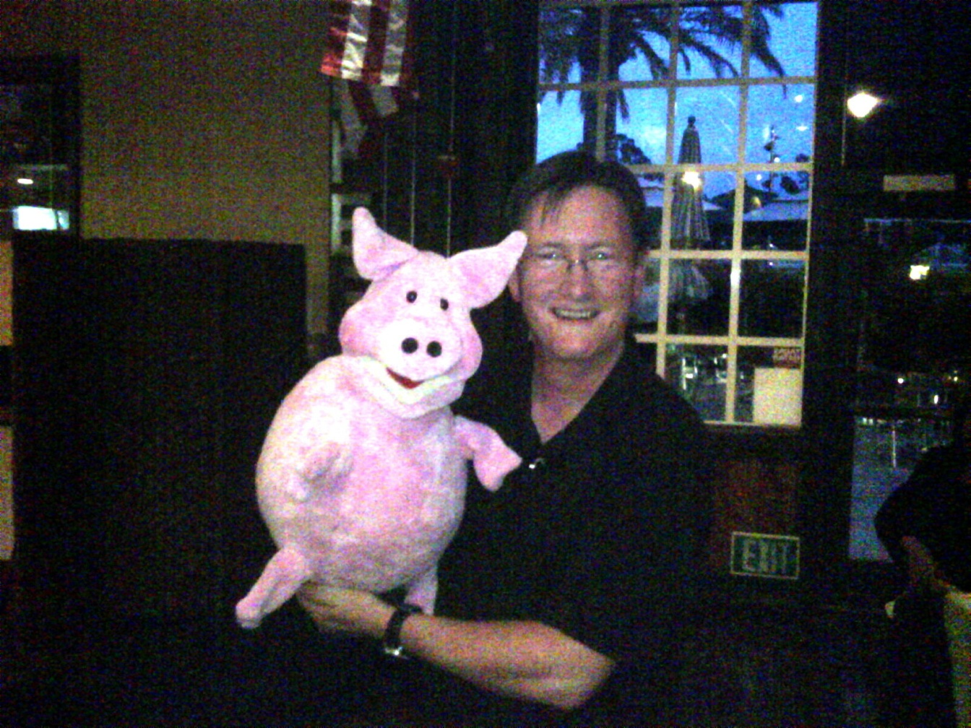
Questions?
President Roger Carroll

